Slide 1
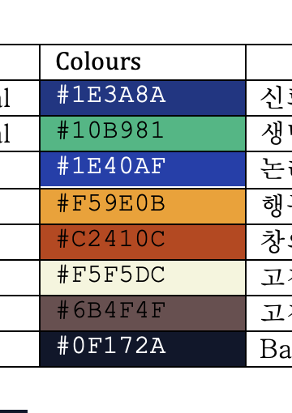
Enterprise Diverse Data Integration Pipeline: photos, music, metadata, and flat files
DongHwan Won / Dylan H Won
Enterprise-diverse-data-integration-pipeline

Slide 2
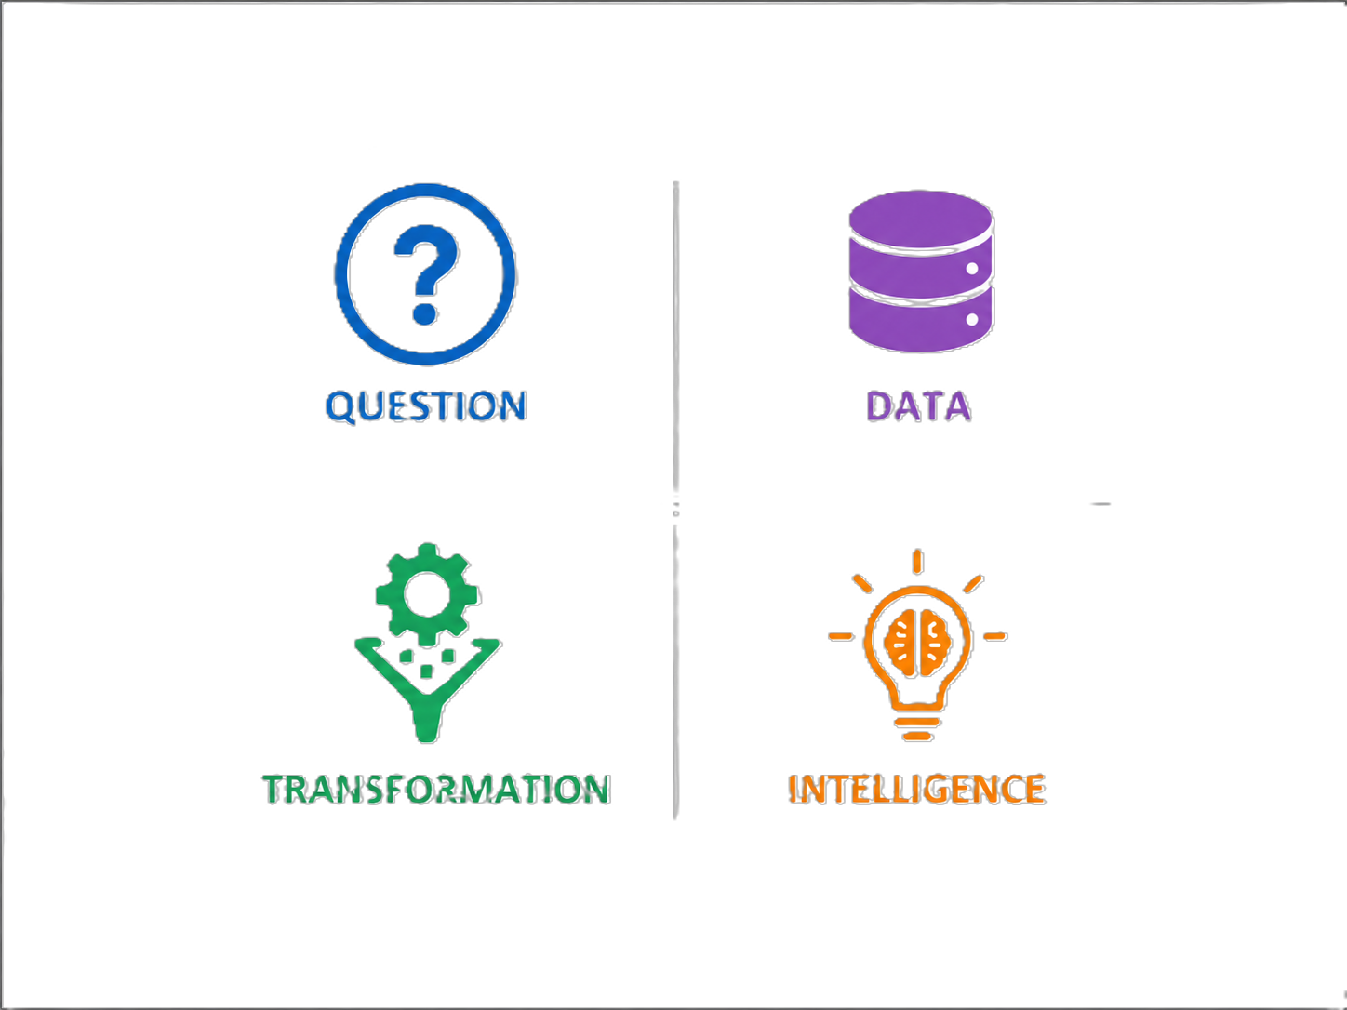



Enterprise Diverse Data Integration Pipeline
Summary
Transformation
Business Needs
Business Needs
Modern organizations manage diverse and unstructured data beyond traditional spreadsheets, including flat files, image metadata, multimedia files, and large-scale external datasets. These data sources often contain inconsistent formats, duplicated records, missing values, and unreliable metadata, making direct analysis difficult.
This project develops an enterprise-style data integration pipeline using Python and Microsoft SQL Server to load, validate, transform, and integrate heterogeneous data through staging-based ELT workflows, ensuring data quality, normalization, referential integrity, and scalable analytical processing.
Diverse data
: multimedia, photo, music etc.
Intelligence
Unstructured data, meta data
Designed reusable dimensional data models using Star Schema and Snowflake Schema architectures to support scalable analytics, improve query performance, and enable future business intelligence and reporting integration.
Data extraction
Large volumes
Structured data, Flat data: 29 columns and tried to handle total 17,338,205 rows.
WAREHOUSE:
LOADING
WAREHOUSE:
LOADING
Load data (as string type) in Microsoft-sql server
Integrated heterogeneous data sources — including flat files, image metadata, and large-scale structured datasets — into a centralized data warehouse through staged ETL/ELT pipelines, ensuring scalable and reliable data loading.
Applied data cleansing, transformation, normalization, and batch-loading strategies to improve data integrity, reduce redundancy, and support consistent analytical processing across enterprise warehouse environments.
11 cm

